Slide 1
EC-024 Digital Image Processing
Integral University
Piyush Charan
Assistant Professor
Department of Electronics and Communication Engineering

Slide 2
Unit 5
Three Dimensional
Image Processing

Slide 3
Three-Dimensional Image Processing
Spatially Three-Dimensional Images
CAT (Computerized Axial Tomotography
Stereometry
Stereoscopic Display
Shaded Surface Display

Slide 4
Basic Concept behind 3D imaging
If we can somehow get the sliced images of an object and then try to reconstruct the image , then it may eventually be possible to reconstruct an object’s image in 3D.

Slide 5
Optical sectioning
Problem with conventional optical microscope: only structure near the focus plane is visible
Serial sectioning (slicing the specimen into a series of thin sections and acquiring the image of each section) can be used to solve the problem but it has 2 major disadvantages:
loss of registration when sections become separated
geometric distortions
Optical sectioning is achieved by digitizing the specimen with the focal plane situated at various levels along the optical axis

Slide 6
Definition of Registration
Image Registration is a process of overlaying two or more digital images of the same scene taken at different times or at the same time by different image sensors.
The final information(3D image) is obtained by combining various data (2D images).

Slide 7
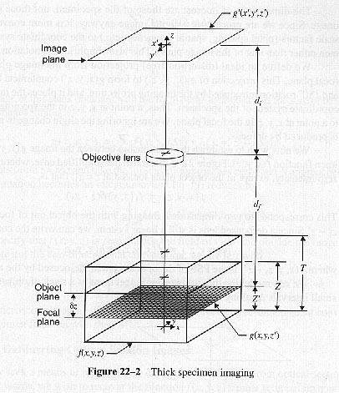
Thick specimen imaging

Slide 8
Thick specimen imaging (cont’d)
The focal length of the objective lens determines the distance d_{f} to the focal plane from the lens equation:
1/d_{i} +1/d_{f} = 1/f
and the magnification of the objective is
M = d_{i} / d_{f}

Slide 9
Thick specimen imaging (cont’d)
We can place the focal plane at any desired level z’. The focal plane of the objective is related to the other microscope parameters by
f = d_{i}/(M+1) = (d_{f} .M)/(M+1) = (d_{i}d_{f})/(d_{i}+d_{f})
and the distance from the center of the lens to the focal plane is
d_{f} = d_{i}/M = (M+1)f /M = fd_{i} /(d_{i}-f)

Slide 10
Computerized Axial Tomography (CAT)
Conventional radiography
Using X-rays
Some structures in human body absorb X rays more heavily than other structures
No lenses are used
Projection (2 dimensional) of the object is recorded
Multiple views are frequently used to resolve ambiguities

Slide 11
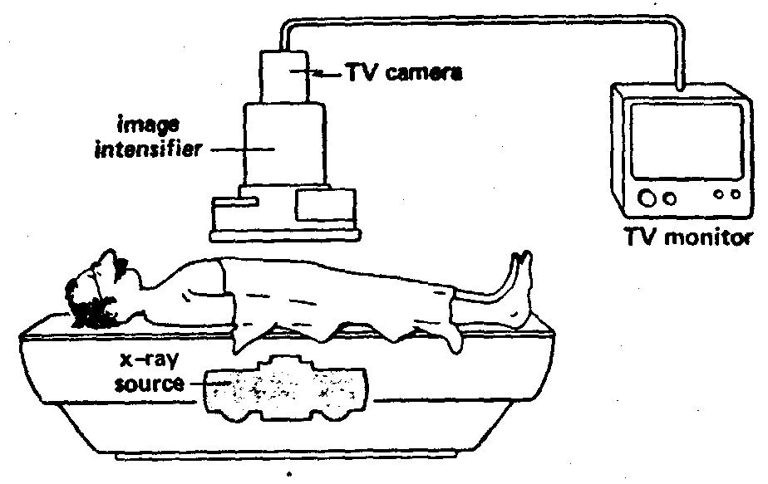
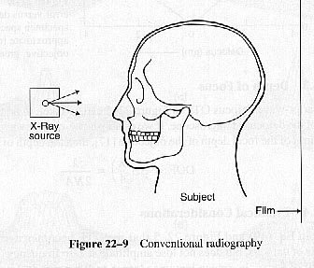
Conventional radiography

Slide 12
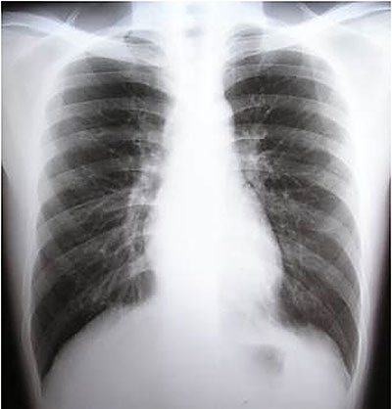
Images obtained by Conventional Radiography

Slide 13
Tomography
Tomography
Useful where image detail is required in deeply imbedded structures such as those of the middle ear
One disadvantage: high dosage of X-ray

Slide 14
CAT Scan Animation

Slide 15
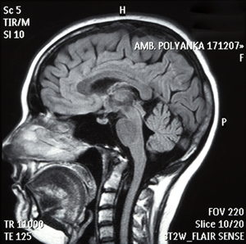
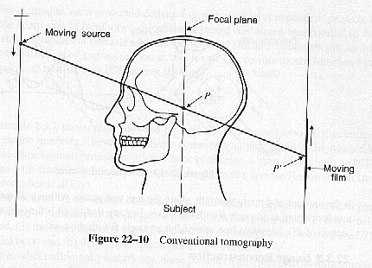
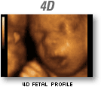
Tomography

Slide 16
CAT
Computerized axial tomography (CAT)
CAT is a technique that incorporates digital image processing to obtain 3-D images
The CAT scanner rotates about the object to acquire a series of exposures
The resulting set of 1-D intensity functions is used to compute a 2-D cross-sectional image of the object at the level of the beam
The beam is moved down the object in small steps producing a 3-D image

Slide 17
CAT

Slide 18
Stereometry
Stereometry is a technique by which one can deduce the 3-D shape of an object from a stereoscopic image pair
Image of the object can be recorded by measuring the brightness of each pixel on the image plane
The distance from the center of the lens to the point p defines the range of this pixel
A range image can be generated by assigning each pixel a gray level proportional, not to its brightness, but to the length of its pixel cone

Slide 19
Stereometry

Slide 20
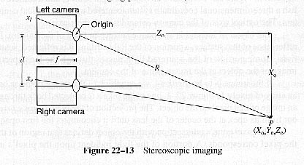
Stereoscopic Imaging

Slide 21
Range equations
Range equations
Suppose that the point P, with coordinates (X₀, Y₀, Z₀) is located in front of the cameras
We can show that a line from P through the center of the left camera will intersect the Z = -f plane at

Slide 22
Range equations
Similarly for the right camera
We now setup a 2-D coordinate system in each image plane with a 180º rotation, thus

Slide 23
Range equations
Now the coordinate of the point images are
and
Rearranging both equations

Slide 24
Range equations
Solving for Z_{0,} gives
the normal-range equation.
We can also write

Slide 25
Range equations
Substitute Z₀ gives the true-range equation:

Slide 26
Range calculations
For each pixel in the left image, determine what pixel position in the right image corresponds to the same point on the object. This can be accomplished on a line-by-line basis.
Calculate the difference x_{r}- x_{l} to produce a displacement image, in which gray level represents pixel shift.
Using the displacement image, calculate Z_{o} at each pixel to produce a normal range image.

Slide 27
Range calculations
Calculate the X and Y coordinates of each point by:
Now we can calculate the X,Y,Z-coordinates of every point on the object that maps to a pixel in the camera.
Finally, compute R as a function of X and Y to produce a true-range image.

Slide 28
Range calculations
Notes (for boresighted cameras):
If Z₀ >> d , the cameras must be converged to ensure that their fields of view overlap to include the objects in the near field. The range equations are slightly more complex.
If the cameras are not in the sample plane, the equations are even more complex.
Cameras geometry can be computed from a pair of stereo images.

Slide 29
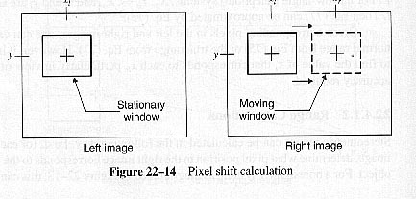
Stereo Matching
The following figure illustrates a technique that locates the right image pixel position that corresponds to a particular left image pixel.

Slide 30
Stereo Matching
Suppose the given pixel in the left image has coordinates x_{l}, y_{l}
Fit the imaginary windows around that pixel and the pixel having the same coordinates in the right image
Compute a measure of agreement (using cross-correlation-- a sum of squared differences)
Move the window in the right image to the right to find maximum agreement, thus x_{r}-x_{l} can be found

Slide 31
Stereo Matching
Notes:
Noise tends to corrupt the image agreement measure
Increase window size to ignore noise but this reduces the resolution of the resulting range image
It is difficult to determine the range of a smooth surface. Projection of random texture onto such surface can be helpful

Slide 32
Stereometry with Wide-Angle Cameras
Used in Viking Mars Lander spacecraft
Two digitizing cameras (angle scanning cameras) are spaced 1 meter apart
The coordinates of a pixel are given by the azimuth and elevation angles of the centerline of its pixel cone
The azimuth is the angle between the yz-plane
The elevation angle is the angle between the xz-plane
Normal-range equation components in terms of the two camera azimuth coordinates and are written as follow:
is the elevation coordinate and is the same for both cameras

Slide 33
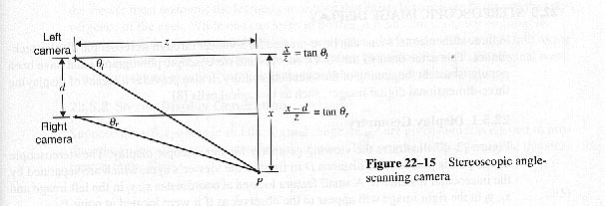
Stereometry with Wide-Angle Cameras

Slide 34
Stereometry with Wide-Angle Cameras
The azimuth is the angle between the yz-plane
The elevation angle is the angle between the xz-plane

Slide 35
Stereometry with Wide-Angle Cameras
Normal-range equation components in terms of the two camera azimuth coordinates and are written as follow:
- is the elevation coordinate and is the same for both cameras

Slide 36
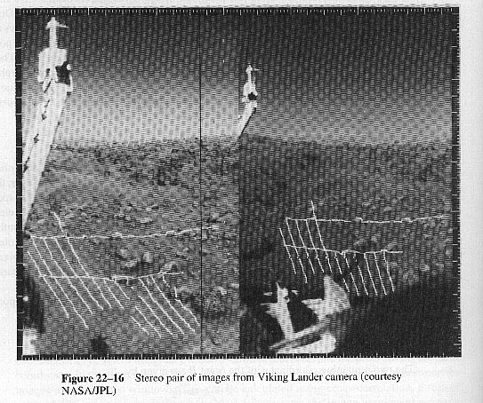
Stereometry with Wide-Angle Camera (Cont’d)

Slide 37
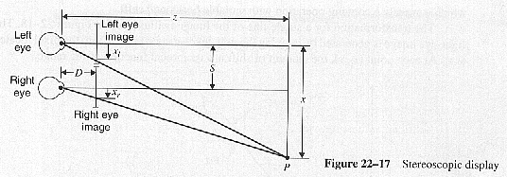
Stereoscopic Image Display
Range relation

Slide 38
Stereoscopic Image Display
If the relationship DS = fd is satisfied, the scene will appear as if the observer had viewed it firsthand
Two conditions must be met to obtain accurate reproduction of a 3-D scene:
There should be converging lenses in front of each of the viewer’s eyes so that the viewer can focus his/her eyes at infinity and still see the two transparency in focus. Positive lenses of focal equal to D are commonly used
The viewing geometry is exact only when the viewer’s line of sight falls along the z-axis.

